Slide 1
Authentication Methods

Slide 2
Journey Summary
AIS (via App)
AIS Re-Auth (via App)
AIS Browser
PIS (via App)
PIS Browser
CBPII App
CBPII Browser
Notes:
To check – I’ve reduced these down to one screen – this seems to include both the AIS and PIS flavour so I’ve just chosen the AIS one

Slide 3
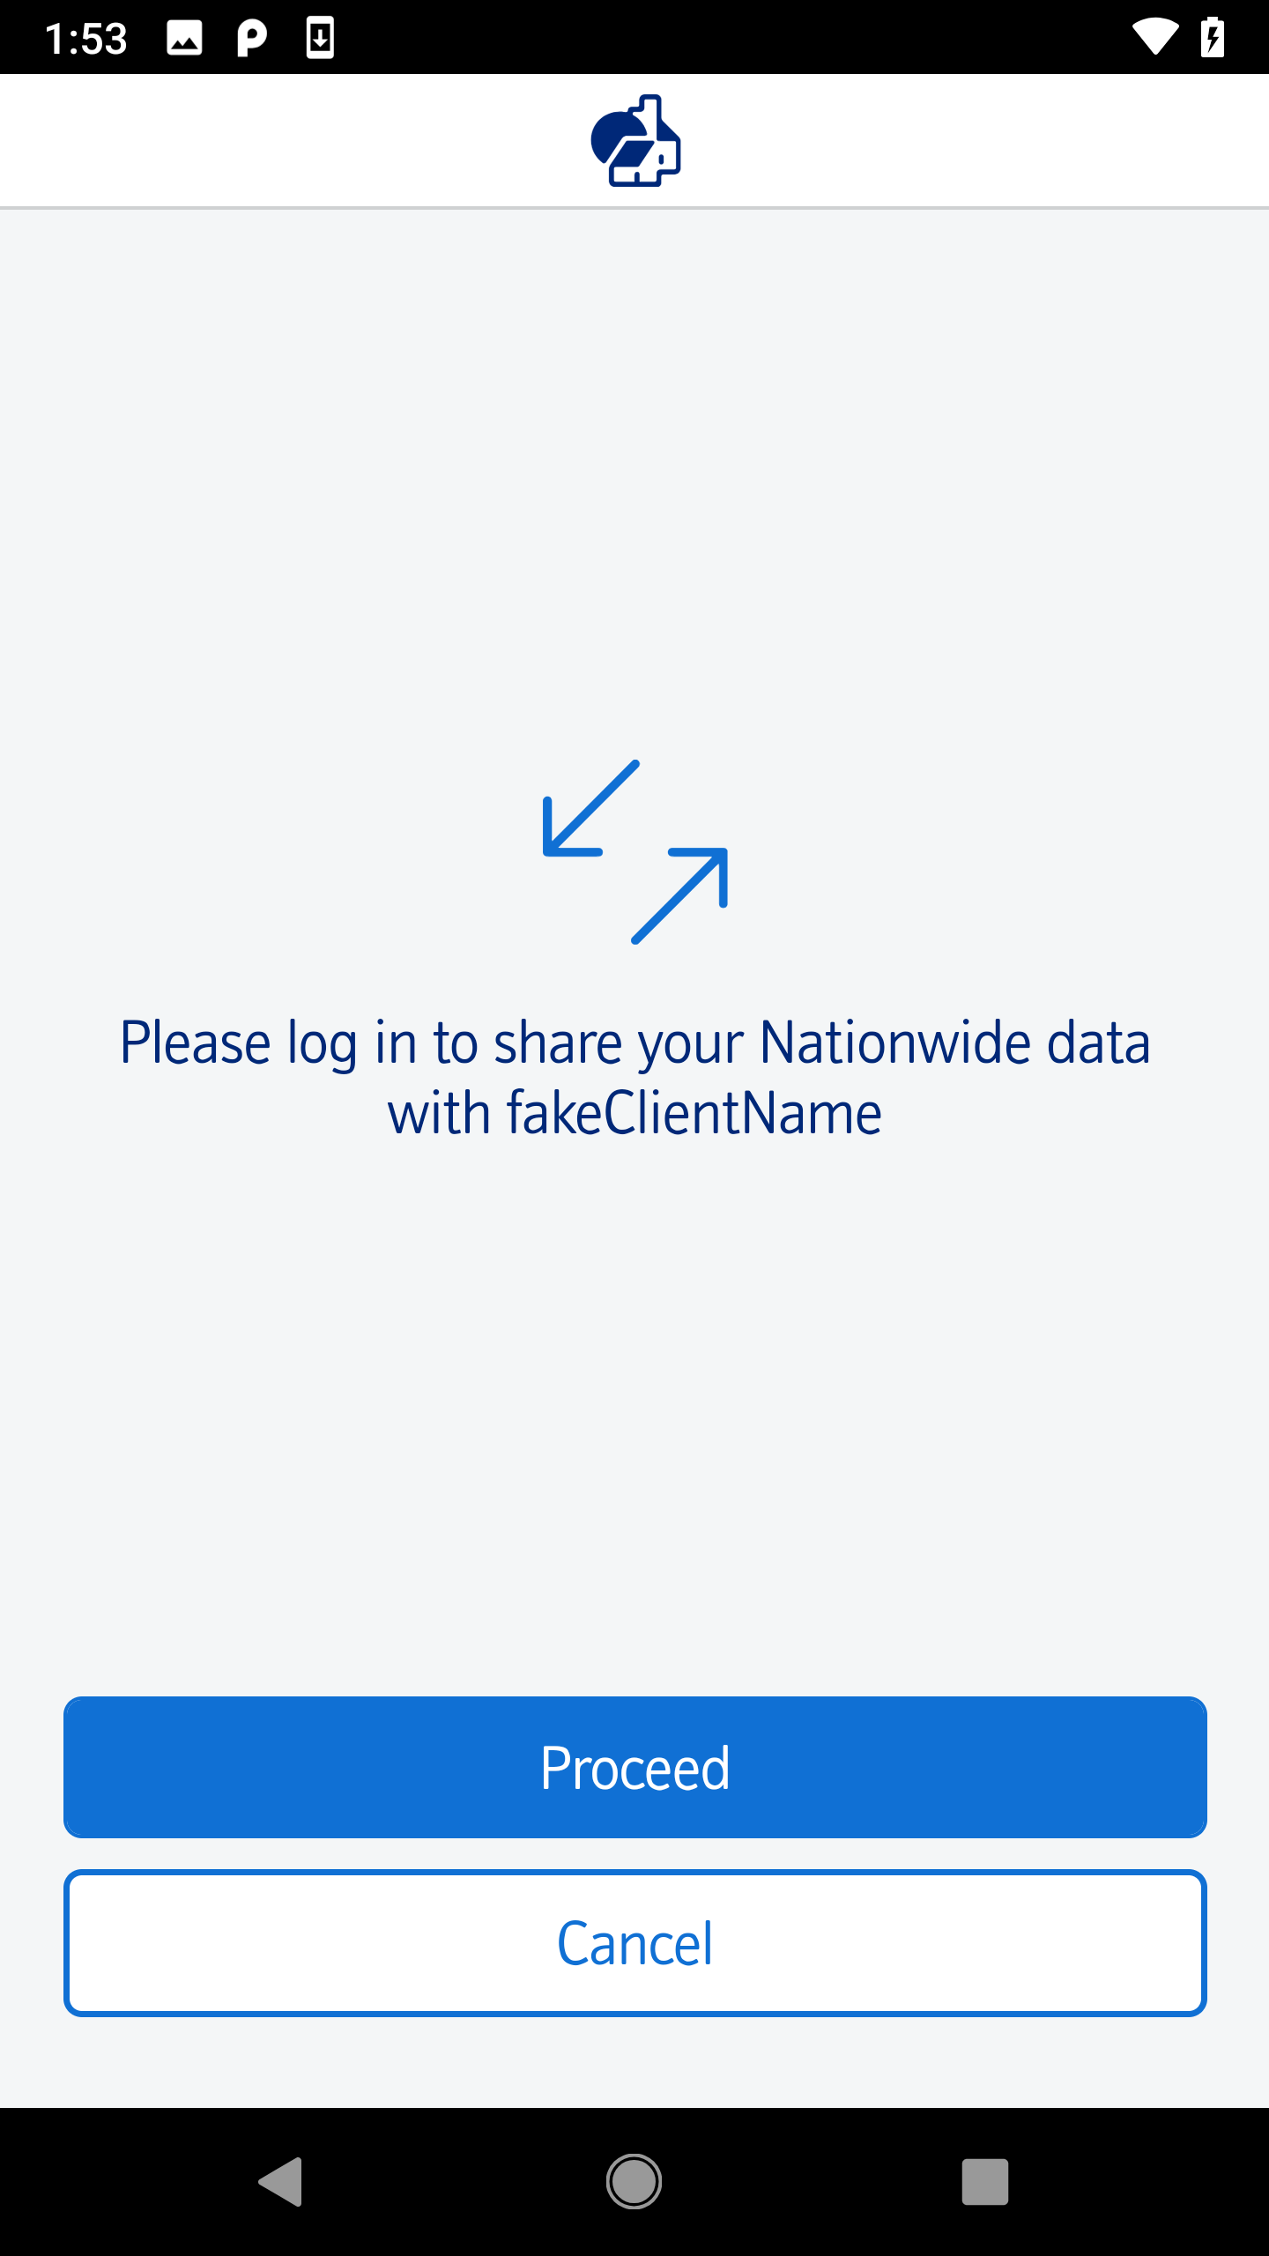
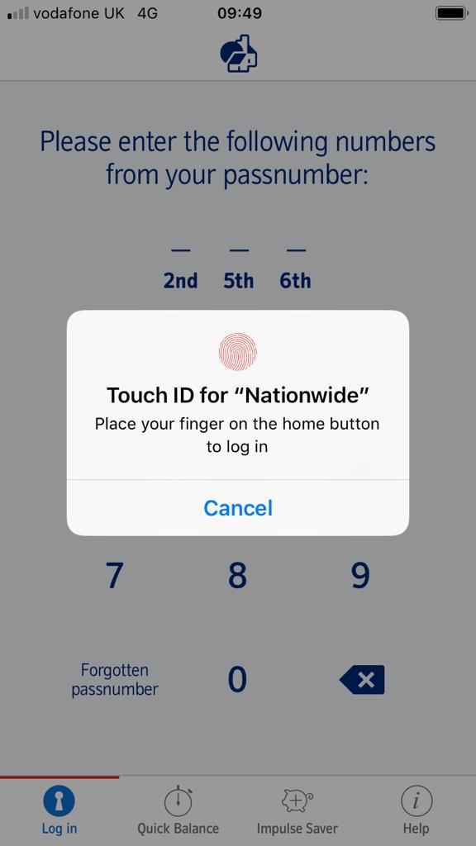
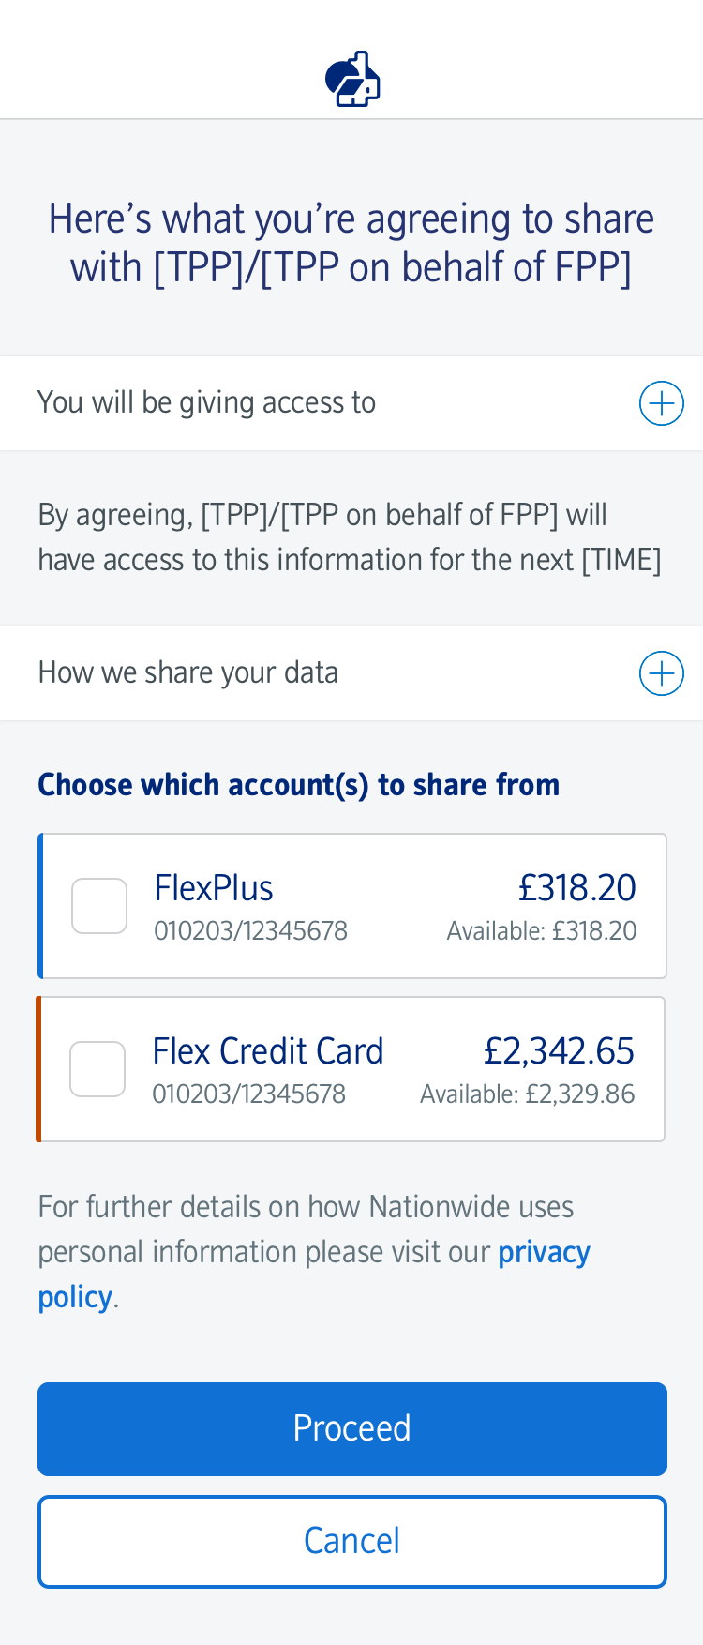
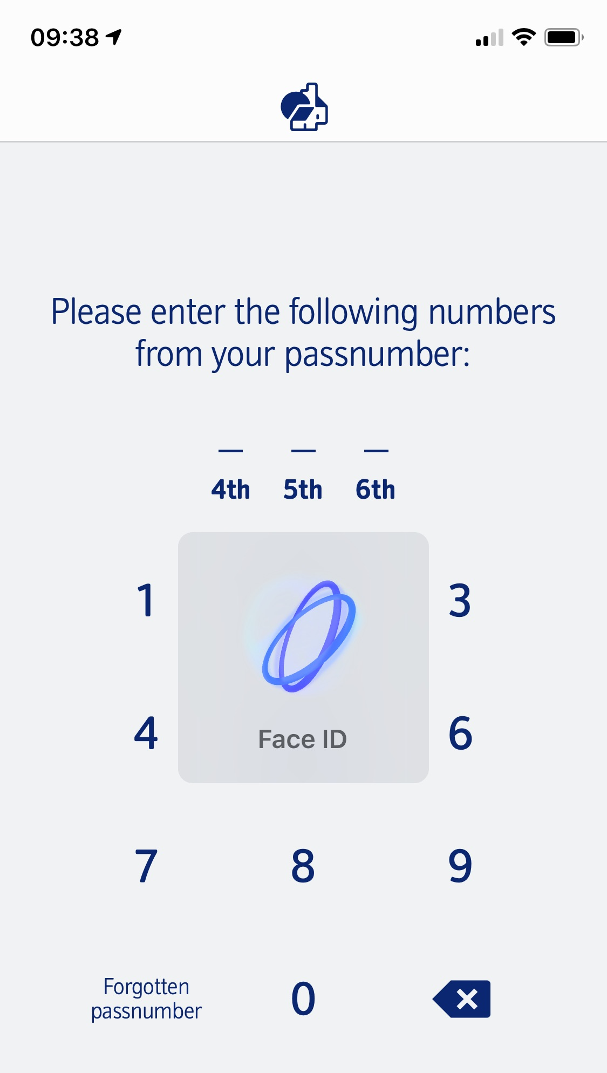
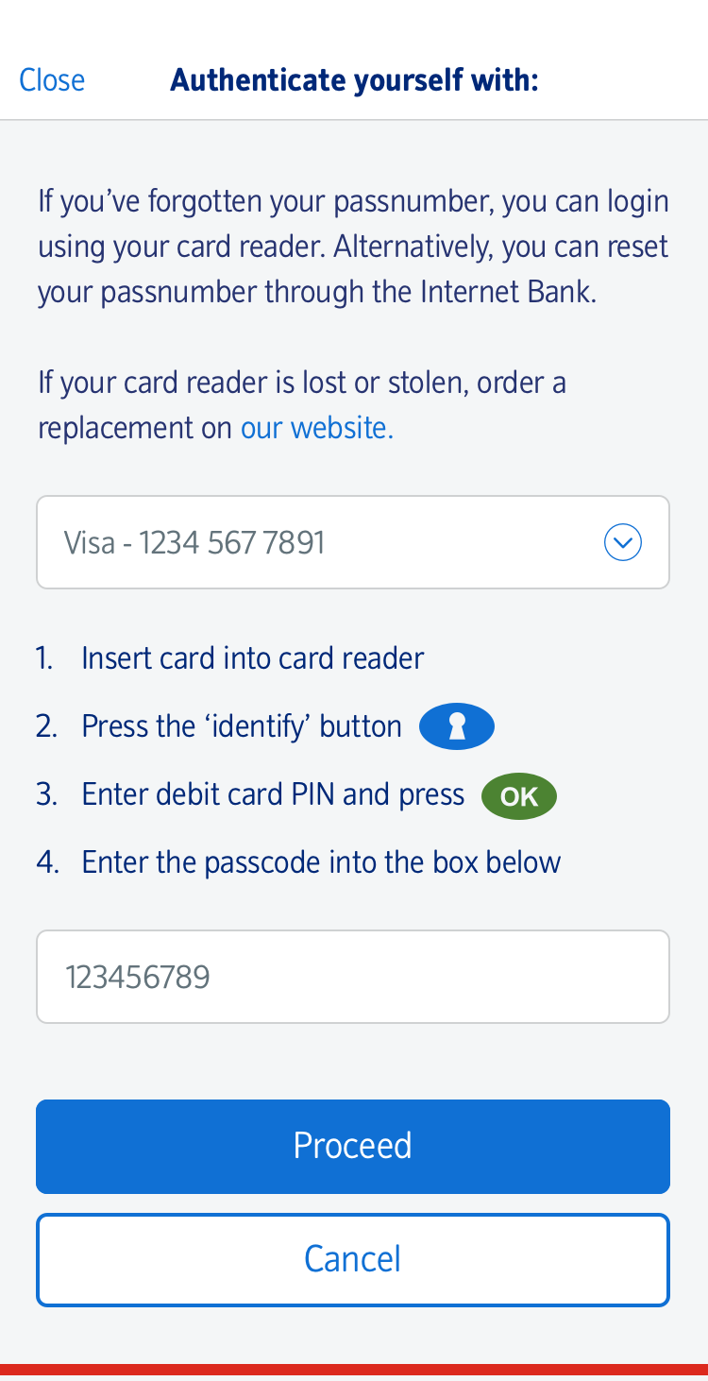
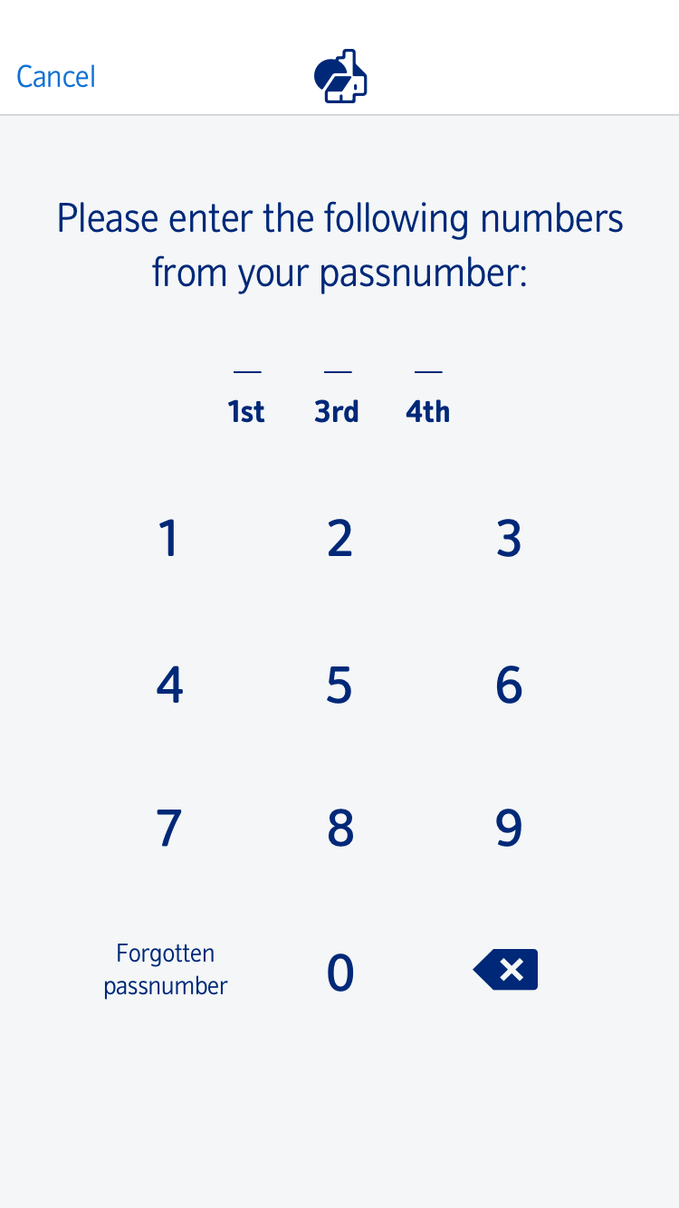
1. AIS Journey (Via App)
1. Loading Page
2. Pre-Auth Screen
3. Authenticate
4. Account Selection
5. Redirect
Nationwide Member consents to AIS at TPP and OB redirection initiated
Fingerprint
Challenge Required?
AISP can request AIS information
Long lived consent is valid
No
No
Yes
Facial Recognition
Yes
Does AIS exemption apply?
No
RCA Identify
Yes
Passnumber
RCA Identify
*Where the AIS exemption can be used ie where there is a long lived consent, balances and transactions, SCA will only be needed every 90 days (TPP should not ask more than 4 times in 24 hours)
Notes:
To check – I’ve reduced these down to one screen – this seems to include both the AIS and PIS flavour so I’ve just chosen the AIS one

Slide 4
2. AIS 90 day re-authentication / AIS data without exemption (via App)
1. Loading Page
2. Pre-Auth Screen
3. Authenticate
5. Redirect
Fingerprint
TPP initiates authorize flow w/ an existing consent
Challenge Required?
AISP can request AIS information
No
Facial Recognition
Yes
RCA Identify
Passnumber
RCA Identify
Notes:
To check – I’ve reduced these down to one screen – this seems to include both the AIS and PIS flavour so I’ve just chosen the AIS one

Slide 5
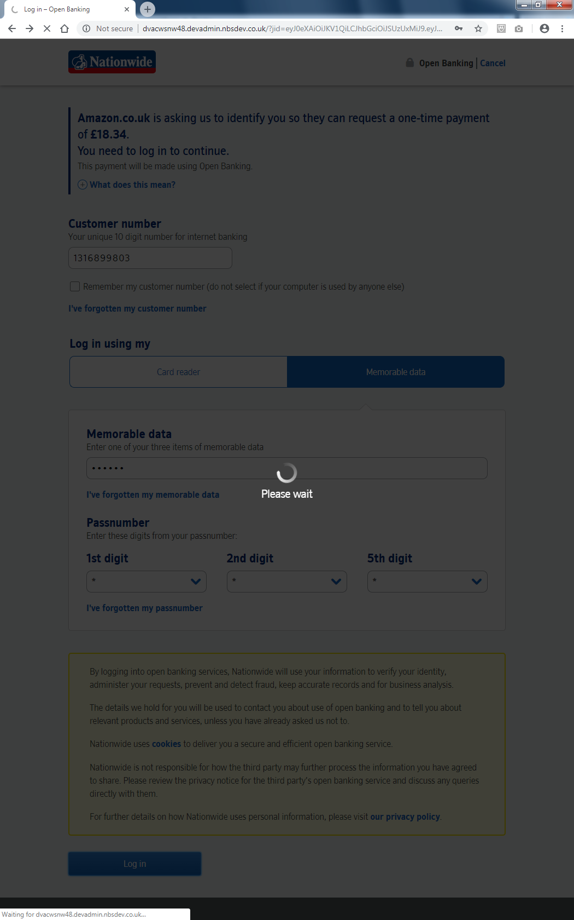
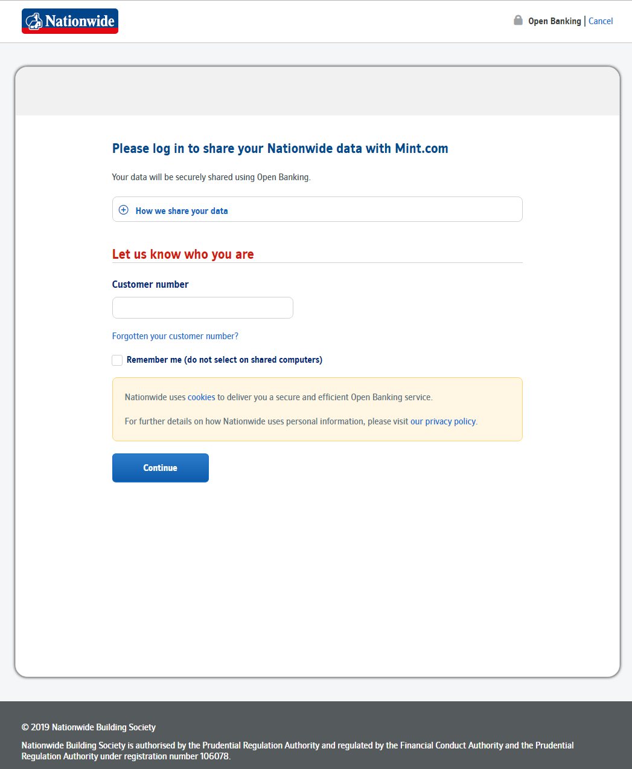
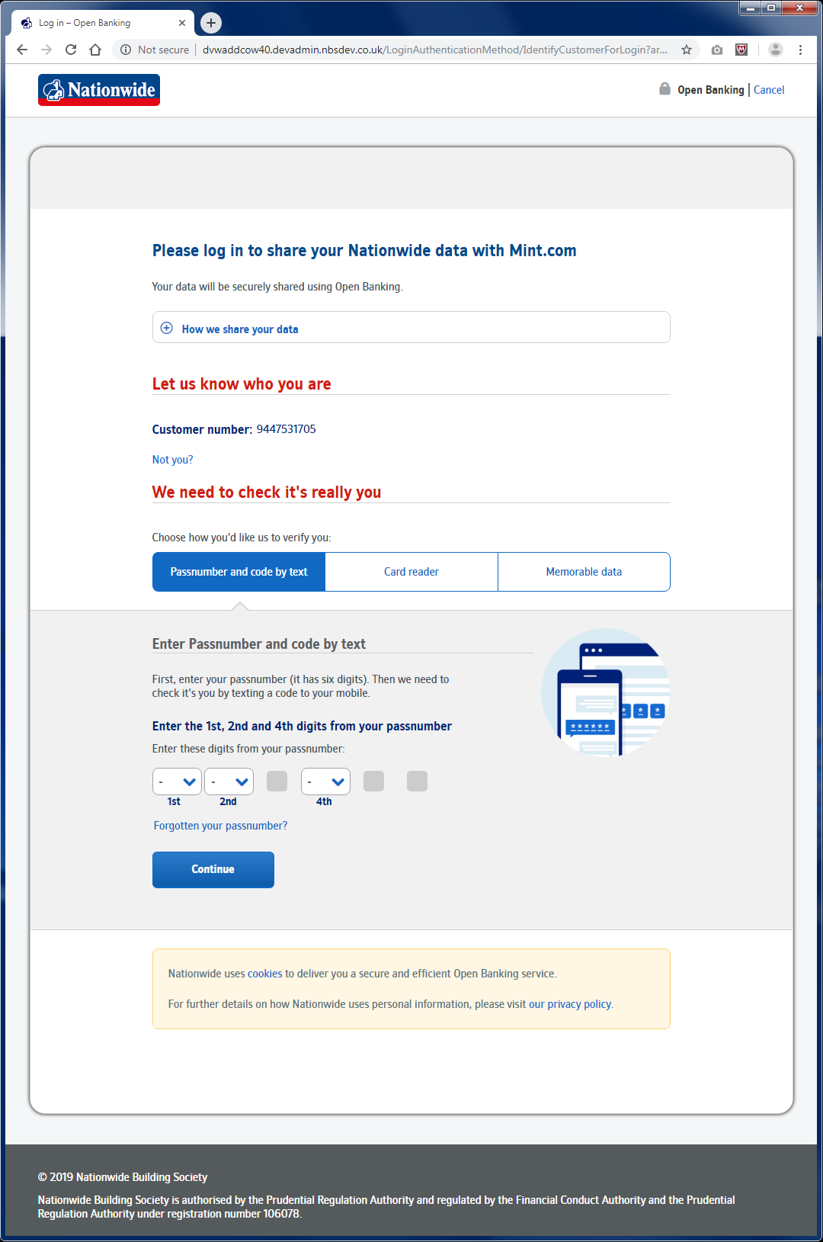
3. AIS consent (via Browser)
NB it is assumed that the TPP has provided the account details
1. Authenticate
2. Account Selection
Customer number entry
Authentication method
Challenge Required?
No
Yes
RCA Identify
Notes:
To check – I’ve reduced these down to one screen – this seems to include both the AIS and PIS flavour so I’ve just chosen the AIS one

Slide 6
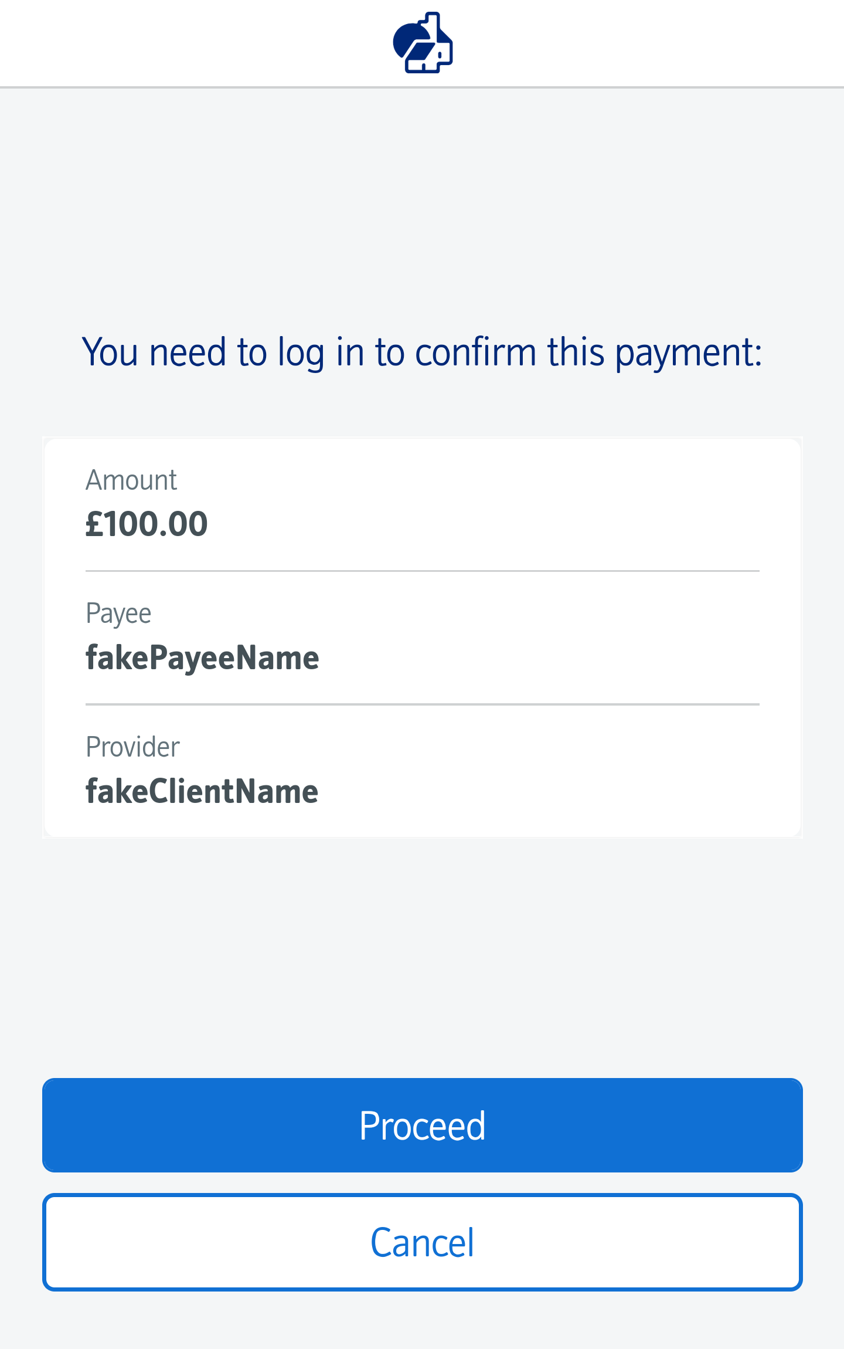
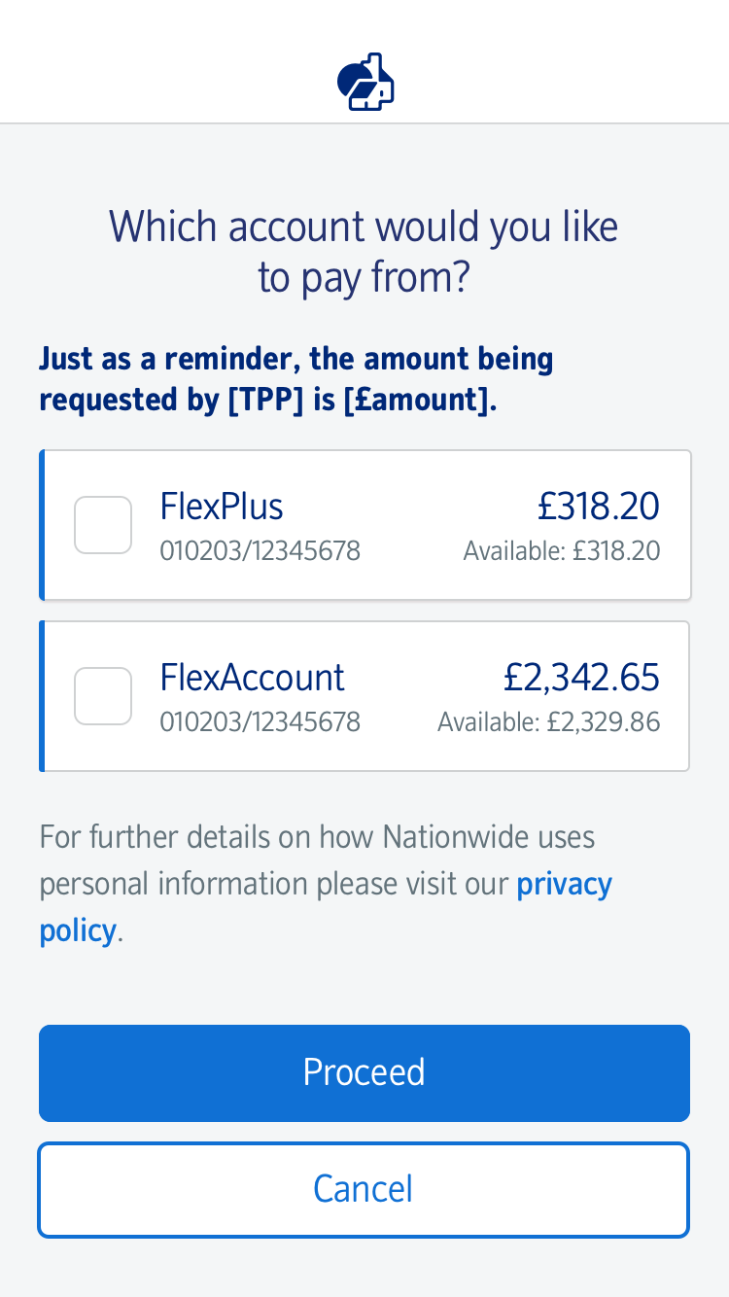
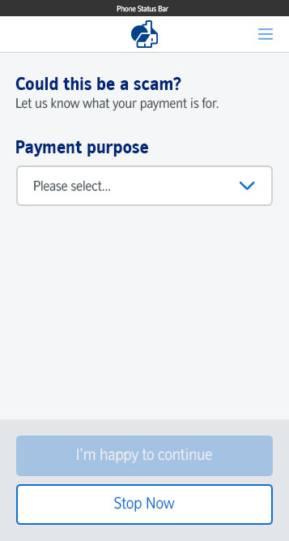
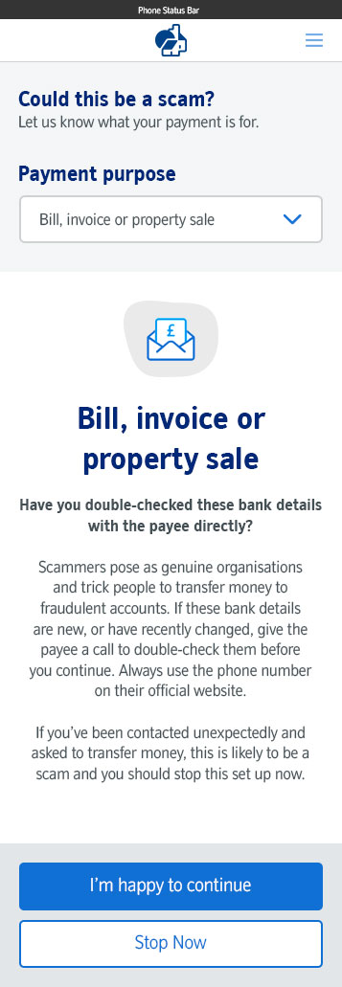
4. Payment (Via app)
1. Loading Page
2. Pre-Auth Screen
3. Authenticate
5. Redirect
Nationwide Member consents to PIS at TPP and OB redirection initiated
Fingerprint
PISP can submit payment
Account Selection Required
No
CRM Screen Required?
No
Challenge Required?
No
Facial Recognition
Yes
Yes
Yes
4. Account Selection
RCA Sign
Passnumber
RCA Identify
An authorisation code is sent to the TPP, an authentication code is generated and the payment is dynamically linked
Notes:
To check – I’ve reduced these down to one screen – this seems to include both the AIS and PIS flavour so I’ve just chosen the AIS one

Slide 7
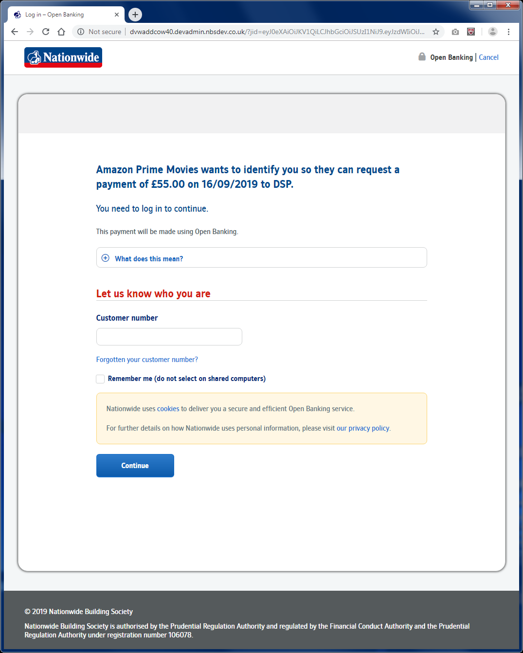
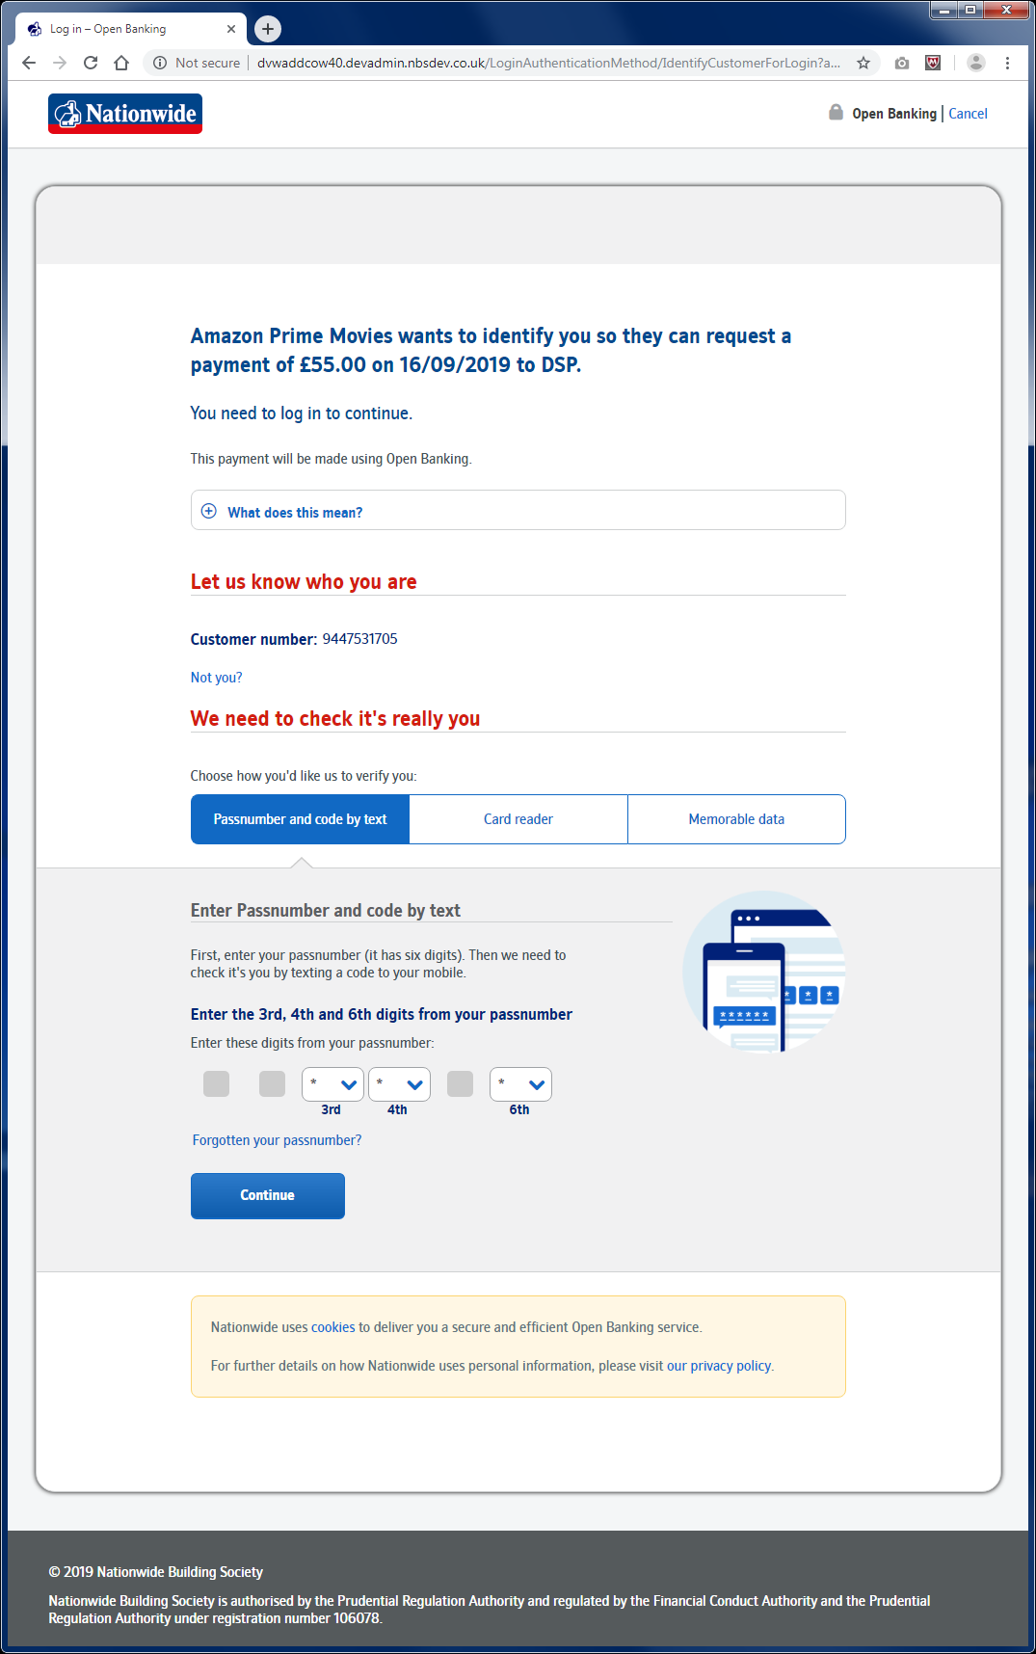
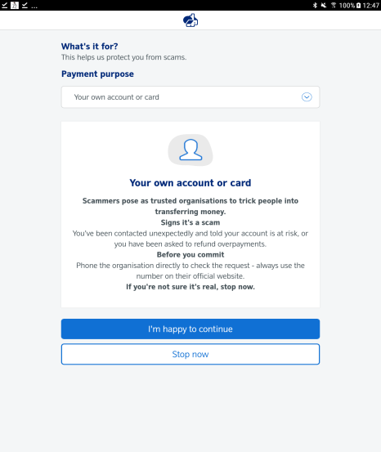
5. Payment (Browser)
1. Authenticate
2. Account Selection
Nationwide Member consents to payment at TPP
TPP initiates OB redirection
Customer number entry
Authentication method
Challenge Required?
Account Selection Required
No
CRM Screen Required?
No
No
No
Yes
Yes
Yes
RCA Sign
An authorisation code is sent to the TPP, an authentication code is generated and the payment is dynamically linked
Notes:
To check – I’ve reduced these down to one screen – this seems to include both the AIS and PIS flavour so I’ve just chosen the AIS one

Slide 8
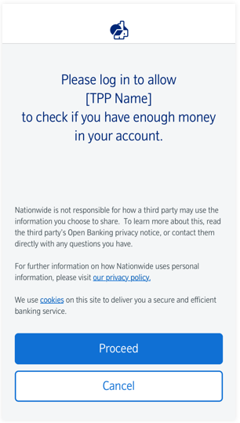
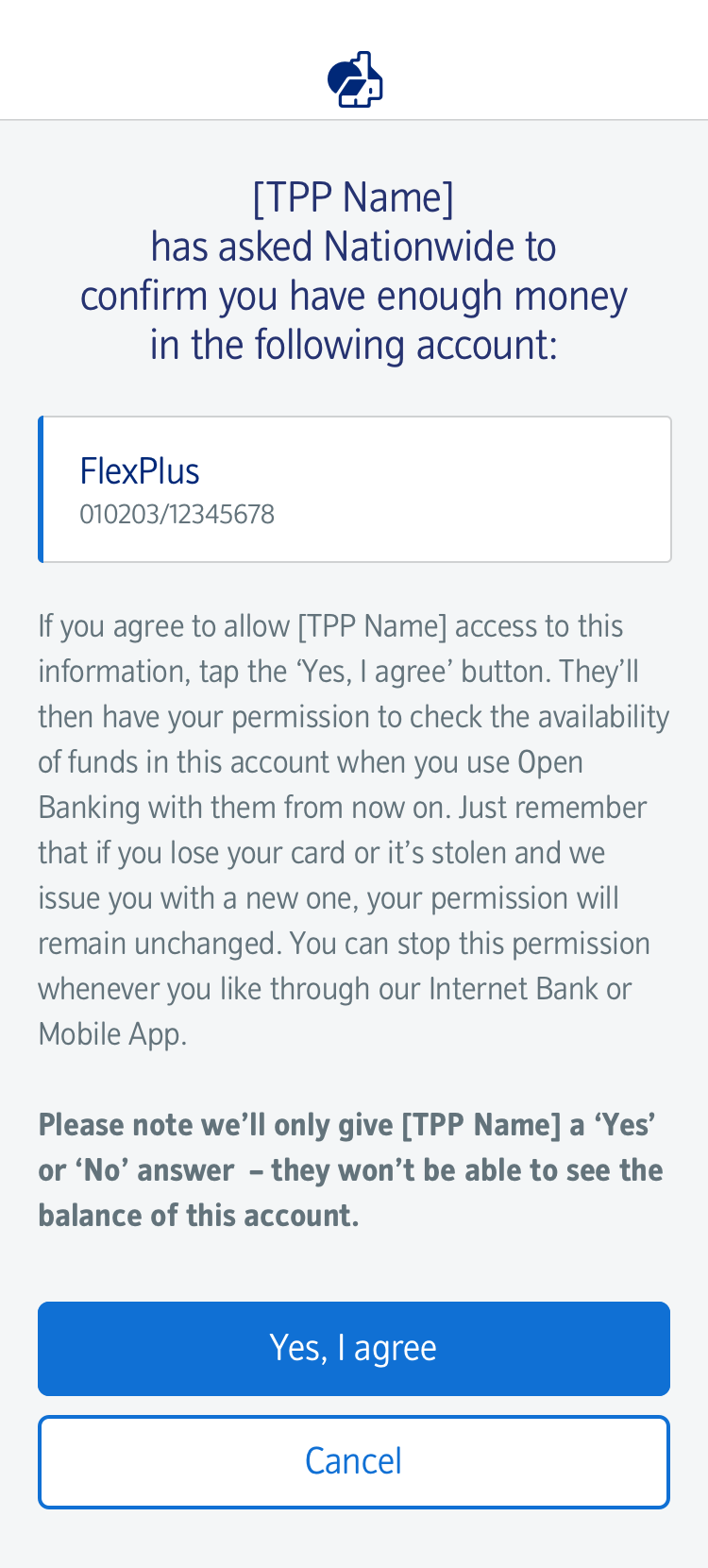
6. CBPII via App
1. Loading Page
2. Pre-Auth Screen
3. Authenticate
4. Take Consent
Fingerprint
CBPII redirects member to NBS to provide consent for confirmation of funds
Challenge Required?
Yes
Facial Recognition
No
RCA Identify
Passnumber
RCA Identify
Notes:
To check – I’ve reduced these down to one screen – this seems to include both the AIS and PIS flavour so I’ve just chosen the AIS one

Slide 9
7. CBPII consent (via Browser)
1. Authenticate
2. Take Consent
3. Redirect
CBPII redirects member to NBS to provide consent for confirmation of funds
Customer number entry
Authentication method
Challenge Required?
No
Yes
RCA Identify
Notes:
To check – I’ve reduced these down to one screen – this seems to include both the AIS and PIS flavour so I’ve just chosen the AIS one

